Slide 1
The Digital Sin City: An Empirical Study of Craigslist’s Impact on Prostitution Trends
Probal Mojumder Carlson School of Management University of Minnesota mojum003@umn.edu | Jason Chan Carlson School of Management University of Minnesota jchancf@umn.edu | Anindya Ghose Stern School of Business New York University aghose@stern.nyu.edu
23rd June 2016
@ SCECR 2016

Slide 2
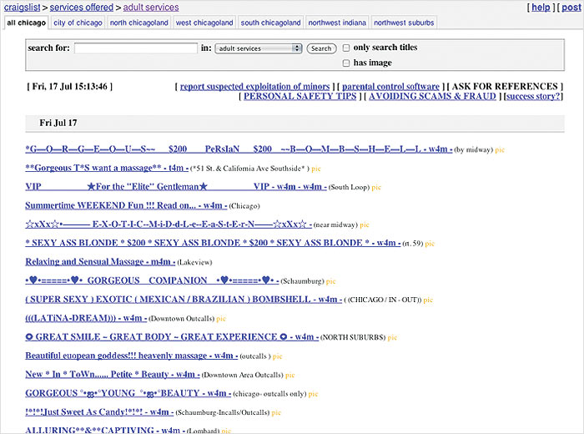
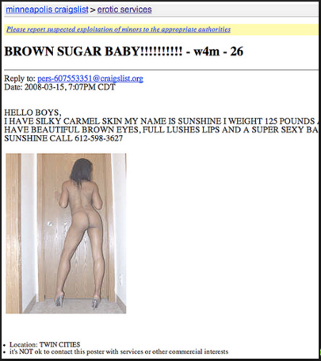
Craigslist and Prostitution Advertisements
Chicago Craigslist > Adult Services
Minneapolis Craigslist > Erotic Services
Source: Chicago Tribune, June 18, 2008
Source: Online Media Daily, July 17, 2009

Slide 3
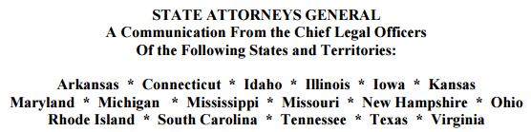
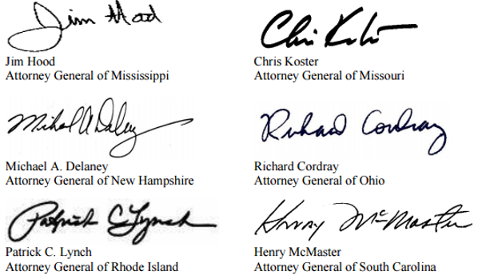
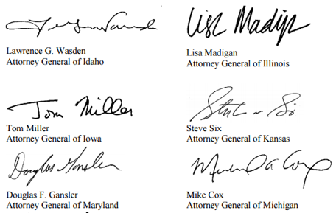
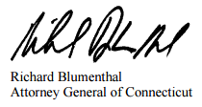
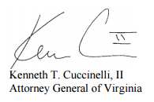

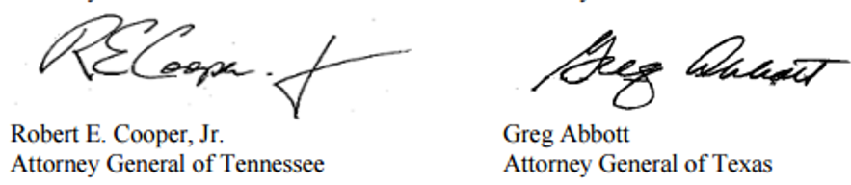
Community and Government Protest against Prostitution Related Posts
In August 2010, seventeen state attorneys general sent an open letter to the founder and CEO of Craigslist, and requested the immediate take down of the Adult Services section of Craigslist.
Link - https://www.texasattorneygeneral.gov/newspubs/releases/2010/082510craigslist_signon.pdf

Slide 4
Main Research Question
Our research studies the Economic Impact of Craigslist’s entry on Prostitution Incidences.
Question 1a: Does Craigslist leads to more prostitution incidences?
Question 1b: If yes, how big is the impact size?

Slide 5
Rational Choice Theory and Prostitution
Based on Becker’s (1974) framework on the economics of crime, the decision to engage in a criminal act is a rational process in which individuals make choices that maximizes their utility.
Accordingly, in making a choice to participate in the prostitution market, the providers and clients alike would weigh the relative benefits and costs when deciding whether to engage in paid sexual transactions.
 | Benefits | Costs
For Prostitutes | Financial gains | Legal punishments
For Clients | Sexual desires | Legal punishments

Slide 6
How Can Online Platforms Influence Prostitution Market?
Studies Supporting Increase In Prostitution Incidence
Bring about reduced search costs (Bakos 1997, Il-Hann and Terwiesch 2003) by facilitating communication across spatial and temporal boundaries (Bailey and Bakos 1997, Jin and Robey 1999), and
Provide a broader base of product offerings (Brynjolfsson et al. 2003, Jin and Robey 1999).
Studies Supporting Market Failure
Presence of high levels of uncertainty (Dimoka et al. 2012) can reduce consumer trust due to the presence of information overload and equivocality (Grover et al. 2006).
Allows users to assume false identities easily (Cao et al. 2012), thus law enforcement can do sting operations.
Craigslist do not have reputation systems like ads rating and review system to guarantee trust.

Slide 7
Study Highlights
Main Findings: Craigslist increases prostitution incidence.
We also find four underlying Market Mechanisms of Craigslist’s impact on prostitution trends.
Mechanism 1: Craigslist creates a new market for prostitution on top of the existing market operated by the traditional sector.
Mechanism 2: Craigslist facilitated prostitution mainly operates in counties with no past history of prostitution.
Mechanism 3: Craigslist causes spillover of prostitution to a neighboring county without Craigslist.
Mechanism 4: Craigslist leads to a true increase in prostitution, and not merely causes increase in policing efficacy.

Slide 8
Data Sources
FBI’s Uniform Crime Reports (UCR)
Prostitution_{iy}, which is the number of prostitution arrests. It is constructed by summing the number of prostitution arrests across all the reporting ZIP codes in a county for a given year.
Other crime trends, like Commercialized Vice, Driving Under the Influence (DUI), and Vandalism.
Craigslist’s Website
Craigslist Entry_{iy}, which is a dummy variable indicating the entry of Craigslist in county i in year y.
U.S. Census Bureau
Population size,
Age-group proportions,
Racial proportions, and
Individuals below the poverty level
Employment level
Annual Income
FBI’s Law Enforcement Officers Killed and Assaulted Dataset
Number of police employees

Slide 9
Empirical Model: Difference in Difference Estimator
We rely on Craigslist’s expansion in the United States in a natural experiment setup, and apply difference-in-difference estimation with county and time fixed effects.
ln(𝑃𝑟𝑜𝑠𝑡𝑖𝑡𝑢𝑡𝑖𝑜𝑛𝑖𝑦)= 𝛼𝑖+ 𝛽𝑦+𝑔∙𝜸𝑖𝑦+𝑝∙𝐶𝑟𝑎𝑖𝑔𝑠𝑙𝑖𝑠𝑡𝑖𝑦+ 𝑒𝑖𝑦
Where,
y refer to year, y = 1999, … , 2008
𝑃𝑟𝑜𝑠𝑡𝑖𝑡𝑢𝑡𝑖𝑜𝑛_{𝑖𝑦} is the number of prostitution arrests for county i in year y
𝜶_{𝒊} is a vector of county fixed effects
𝜷_{𝒚} is a vector of year fixed effects
𝜸_{𝑖𝑦} is a vector of county-year demographics features, socioeconomic indicators, and crime-related factors
𝐶𝑟𝑎𝑖𝑔𝑠𝑙𝑖𝑠𝑡_{𝑖𝑦} is the binary indicator for Craigslist entry
𝑒_{𝑖𝑦} is error term

Slide 10
Craigslist Leads to Increase in Prostitution Trends
Main Results
OLS and Fixed Effect Regressions Showing Impact of Craigslist Entry on Prostitution, with Robustness Checks
 | OLS | Fixed Effect
Variables | Model 1 | Model 2 | Model 3 | Model 4 | Model 5 | Model 6 | Model 7
Craigslist Entry | 0.241*** | 0.070*** | 0.283*** | 0.073*** | 0.063*** | 0.161* | 0.045**
 | (0.06) | (0.02) | (0.06) | (0.02) | (0.02) | (0.09) | (0.02)
Age 15-19 Proportion | -1.014 | 0.554 | -1.259 | 0.679 | 0.542 | 2.424 | 0.507
 | (0.93) | (0.53) | (0.95) | (0.52) | (0.37) | (6.41) | (0.45)
Age 20-39 Proportion | -0.353 | -0.343 | -0.497 | -0.327 | -0.258 | 1.687 | -0.402**
 | (0.38) | (0.26) | (0.40) | (0.26) | (0.19) | (4.45) | (0.18)
Age 40-59 Proportion | 0.149 | -0.008 | 0.117 | -0.194 | -0.118 | 3.513 | -0.281*
 | (0.54) | (0.22) | (0.57) | (0.20) | (0.16) | (5.89) | (0.15)
White Proportion | -0.030 | -1.383** | 0.003 | -1.203** | -0.850** | -1.636 | -0.758
 | (0.10) | (0.62) | (0.11) | (0.58) | (0.39) | (20.21) | (0.51)
Black Proportion | 0.161 | -0.636 | 0.190 | -0.408 | -0.251 | 4.520 | -0.077
 | (0.14) | (0.53) | (0.15) | (0.50) | (0.35) | (20.17) | (0.43)
Asian Proportion | 3.054* | 0.931 | 3.107* | 1.117 | 0.667 | 36.723 | 1.192
 | (1.61) | (0.93) | (1.66) | (0.98) | (0.62) | (22.65) | (1.30)
Log (Population Size) | 0.069 | 0.136** | -0.029 | 0.116* | 0.116** | 0.960 | 0.086
 | (0.05) | (0.06) | (0.08) | (0.06) | (0.05) | (1.15) | (0.05)
Log (Poverty) | 0.103*** | 0.061** | 0.199** | 0.066** | 0.047** | 0.081 | 0.033
 | (0.03) | (0.03) | (0.08) | (0.03) | (0.02) | (0.31) | (0.02)
Employed Proportion | 1.595*** | -0.309 | 1.907*** | -0.247 | -0.214 | -3.024 | -0.177
 | (0.54) | (0.19) | (0.59) | (0.21) | (0.16) | (3.02) | (0.15)
Log(Annual Income) | 0.081 | 0.005 | 0.247* | -0.015 | -0.014 | 1.345 | 0.131*
 | (0.06) | (0.03) | (0.14) | (0.03) | (0.01) | (0.99) | (0.07)
Log (Police Officers) | 0.057** | -0.020** | 0.054* | -0.021** | -0.014** | -0.310*** | -0.010*
 | (0.03) | (0.01) | (0.03) | (0.01) | (0.01) | (0.10) | (0.01)
Log (All Other Crimes)# | -0.005 | 0.007 | -0.008 | 0.007 | 0.005 | 0.062 | 0.009**
 | (0.01) | (0.01) | (0.01) | (0.01) | (0.00) | (0.93) | (0.00)
County Fixed Effect |  | ü |  | ü | ü | ü | ü
Time Fixed Effect |  |  | ü | ü | ü | ü | ü
Un-Weighted Regression |  |  |  |  | ü
Prostitution Only Counties |  |  |  |  |  | ü
Propensity Score Matching |  |  |  |  |  |  | ü
Clustered Standard Errors | ü | ü | ü | ü | ü | ü | ü
Weighted Regression | ü | ü | ü | ü |  | ü | ü
R-squared | 0.215 | 0.020 | 0.218 | 0.021 | 0.017 | 0.126 | 0.017
F-Stats | 5.774 | 2.694 | 3.919 | 1.854 | 1.937 | 3.075 | 1.511
Observations | 16674 | 16674 | 16674 | 16674 | 16674 | 1326 | 15529
Age
Controls
Ethnicity
Controls
Effect size of 7.57% increase in prostitution trends
Socioeconomic
Controls
Police &
Crime
Controls

Slide 11
No Effect on Alternative Crimes
Falsification Result
Falsification Test Using Alternative Crimes
 | DV = Log (DUI) | DV = Log (Vandalism)
Variables | Model 1 | Model 2
Craigslist Entry | 0.010 | -0.033
 | (0.03) | (0.03)
County Fixed Effect | ü | ü
Time Fixed Effect | ü | ü
R-squared | 0.041 | 0.016
F-Stats | 14.840 | 5.721
Observations | 16674 | 16674
No Effect
No Effect
Note: All control variables are included.

Slide 12
Mechanism 1
Craigslist Creates a New Market for Prostitution
The observed Craigslist-related prostitution trends constitute as a new market on top of the prevailing market operated by organized prostitution rings.
Impact of Commercialized Vice and Craigslist Entry on Prostitution
Variables | Model 1 | Model 2
Log (Commercialized Vice) | 0.743*** | 0.740***
 | (0.04) | (0.04)
Craigslist Entry |  | 0.047***
 |  | (0.02)
R-squared | 0.398 | 0.400
F-Stats | 24.080 | 23.826
Observations | 16674 | 16674
Similar Coefficient
Sizes
Note: All control variables are included.

Slide 13
Mechanism 1 – Add On
Craigslist Creates a New Market for Prostitutes in Age Group 41-50
The new market primarily consist of sex workers in age group 41-50.
Impact of both Craigslist Entry and Commercialized Vice on Prostitution by Age Break-Down
 | Age 0-17 | Age 18-30 | Age 31-40 | Age 41-50 | Age 51-99
Variables | Model 1 | Model 2 | Model 3 | Model 4 | Model 5
Craigslist Entry | -0.000 | 0.016 | 0.002 | 0.029** | -0.003
 | (0.00) | (0.02) | (0.02) | (0.01) | (0.00)
Log (Commercialized Vice) | 0.020** | 0.228*** | 0.167*** | 0.088*** | 0.006
 | (0.01) | (0.04) | (0.05) | (0.03) | (0.00)
R-squared | 0.009 | 0.043 | 0.019 | 0.016 | 0.002
F-Stats | 0.876 | 3.588 | 2.048 | 2.024 | 0.497
Observations | 16674 | 16674 | 16674 | 16674 | 16674
Note: All control variables are included.

Slide 14
Mechanism 2
Craigslist Introduces Prostitution in Counties with No Prior History of Prostitution
The new market for prostitution primarily occurs at counties with no prior history of prostitution before site entry.
Impact of Craigslist Entry over Sample Split based on Presence of Past Prostitution
 | No Cases of Prostitution before Craigslist Entry | Had Cases of Prostitution before Craigslist Entry
Variables | Model 3 | Model 4
Craigslist Entry | 0.042*** | 0.070
 | (0.01) | (0.10)
R-squared | 0.019 | 0.106
F-Stats | 0.931 | 2.313
Observations | 15484 | 1190
Effect size of 4.29% increase in prostitution trends
Note: All control variables are included.

Slide 15
Mechanism 3
Craigslist Entry Causes Prostitution to Spillover to a Neighboring County
We identify nearest county-pairs, where at least one county has Craigslist entry.
Spillover Effect of Craigslist Entry
 | County with site entry | Neighboring county without site entry
Variables | Model 1 | Model 2
Craigslist Entry | 0.201*** | 0.050**
 | (0.05) | (0.02)
Log (Commercialized Vice) | 0.734*** | 1.003***
 | (0.03) | (0.03)
R-squared | 0.521 | 0.711
F-Stats | 28.639 | 67.694
Observations | 756 | 791
5.13% increase in own county prostitution due to Craigslist entry in neighboring county
Note: All control variables are included.

Slide 16





Mechanism 4
Is It True Increase in Prostitution Or Increase in Police Efforts?
We use newspaper reports to locate counties and years in which police departments used sting operations over Craigslist to make prostitution arrests.
For this, we amassed over 600 news articles from four disparate news databases, like Access World News, LexisNexis Academic, ProQuest Newsstand, and Factiva.
Later, we hired online workers from Upwork website to read and label the articles from these databases.

Slide 17
Mechanism 4
After Removing Counties With Police Efforts, We Yet Again Get Increase in Prostitution Trends
Impact of Craigslist Entry on Prostitution after Removing County-Year with Police Stings As Reported in News Articles
 | No County-Year Removed | Removing Exact County-Year with Police Stings | Removing Exact County-Year with Police Sting, and Any Following County-Years
Variables | Model 1 | Model 2 | Model 3
Craigslist Entry | 0.073*** | 0.057*** | 0.058***
 | (0.02) | (0.02) | (0.02)
R-squared | 0.021 | 0.016 | 0.017
F-Stats | 1.854 | 1.823 | 1.809
Observations | 16674 | 16619 | 16605
Effect size of 5.86% increase in prostitution trends
Note: All control variables are included.

Slide 18

Research Implications
There was actual increase in prostitution due to Craigslist’s entry.
Our estimate is like a tip of an iceberg, as true effect can be larger.
Our results can add to similar classified ads websites since they carry prostitution advertisements even to this day!
Finally, online platform also help to facilitate market clearing for illicit markets.

Slide 19
Thank You
Questions?

